Slide 1
Reading ECG
Summary by Thomas Tay
Adapted from The EKG guy

Slide 2
ECG course 2.0 – The heart ant its electrical conduction system
RV = most of anterior view of heart
Heart = 4 chamber pump
SA node → internodal pathways (anterior, middle, posterior) → AV node → Bundle of His → (LBB (→LAF + LPF) + RBB) → Purkinje fibers
SA node = pacemaker of heart
Backup conduction system of the heart

Slide 3
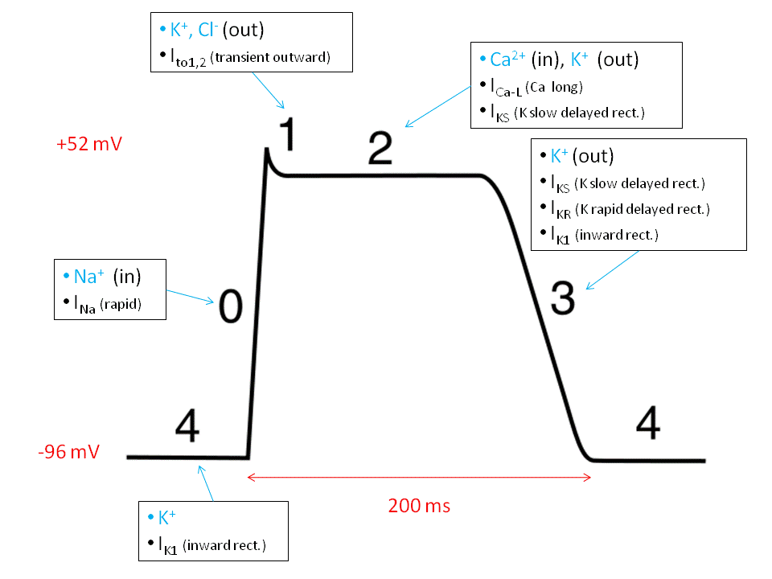
ECG course 3.0 – Electrophysiology of the heart
Base concentrations
Inside: More K
Outside: More Na and Ca
Phase 0 – Fast Na channels open, Na enters cardiomyocyte
Phase 1 – Cl channels open, Cl enters cardiomyocyte
Phase 2 – Slow Na channels and Ca channels open, Na and Ca flows into cell
Phase 3 – Fast K channels open, K flows out of the cell
Phase 4 – Below threshold, slowly rising to threshold due to higher positive charge outside

Slide 4
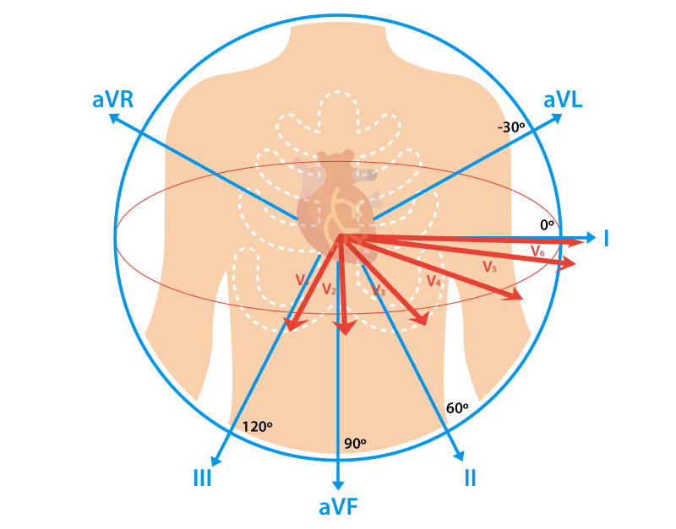
ECG course 4.0 – Vectors and Electrodes
Deflection on ECG
When a positive charge moves away from electrode, ECG deflects downwards
When a positive charge moves towards an electrode, ECG deflects upwards
When a positive charge moves across an electrode, ECG deflects upwards then downwards
Which ECG leads view which parts of the heart
Leads II, III, aVF – inferior part of the heart
Leads V1, V2 – septal part of the heart
Leads V3, V4 - anterior part of the heart
Leads V5, V6, I, aVL – lateral part of the heart

Slide 5
ECG course 5.0 – EKG paper
Horizontal
1 small box = 0.04s
1 big box – 0.2s
Time between 2 black lines = 1 sec
Vertical
10 small box = 1mV
Calibrations
Standard (25mm/s, 10 small box = 1mV)
Half Standard (25mm/s, 10 small box = 2mV)
50mm/s
12-lead ECG
Each lead measured over 2.5 seconds
Full stretch measured over 10 seconds
Everything in a vertical line happened at the same time

